Slide 1
Splash Screen
Shows my logo before dumping into the main menu
Displays a pleasant fading effect

Slide 2
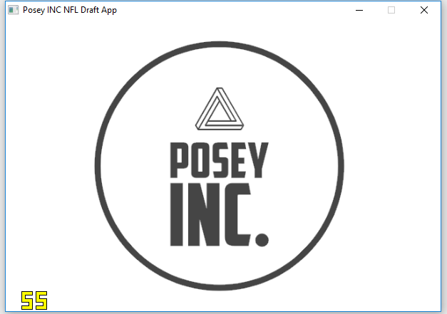

Slide 3
Main Menu
Give the user four options
Offensive Players
Navigates to Offensive Players screen
Defensive Players
Navigates to Defensive Players screen
All Players
Navigates to All Players screen
Create a player
Navigates to Player Stats screen

Slide 4
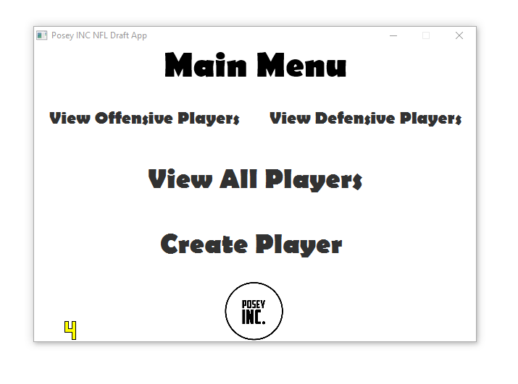

Slide 5
Offensive Players
Shows all Offensive Players in the pre loaded roster
Shows two primary stats: Player and position
Gives user the option to return to main menu, remove player, or view stats which jumps to the Player Stats screen.

Slide 6
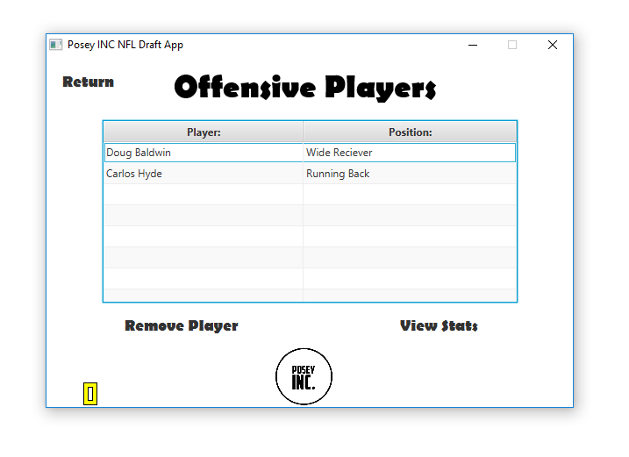

Slide 7
Defensive Player
Shows all Defensive Players in the pre loaded roster
Shows two primary stats: Player and position
Gives user the option to return to main menu, remove player, or view stats which jumps to the Player Stats screen.

Slide 8
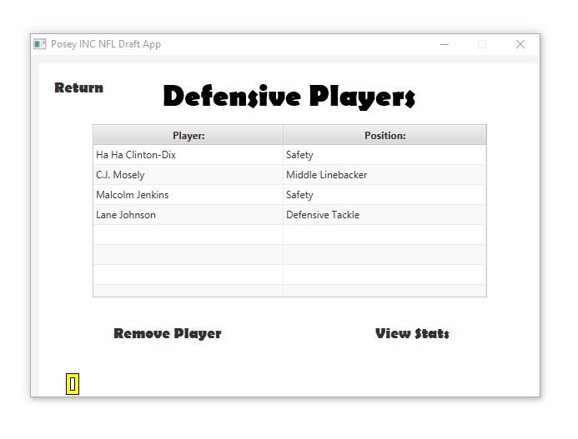

Slide 9
All Players
Shows all Players in the pre loaded roster
Shows two primary stats: Player and position
Gives user the option to return to main menu, remove player, or view stats which jumps to the Stat Screen.

Slide 10
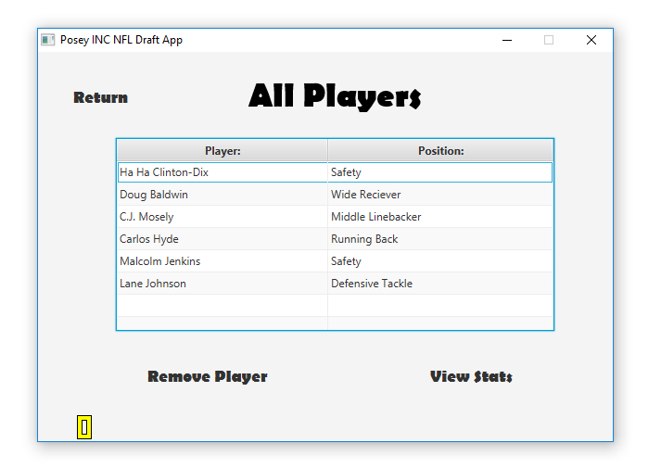

Slide 11
Stat Screen (If Offensive Player was selected)
Shows All of players stats
Name
Position
Height
Weight
Passing Yards
Rushing Yards
Completions
Every field is editable, and upon editing any value a save changes button appears
Return button takes you back to whatever previous screen was
Save Changes button updates the current player’s stats

Slide 12
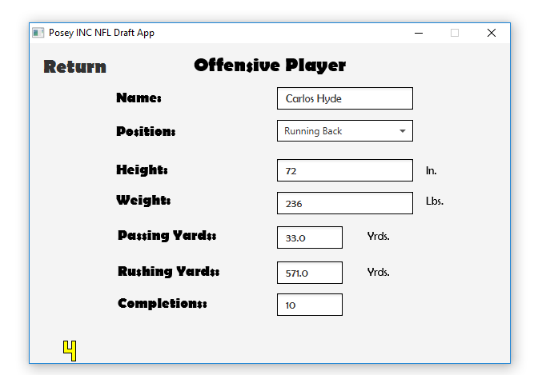
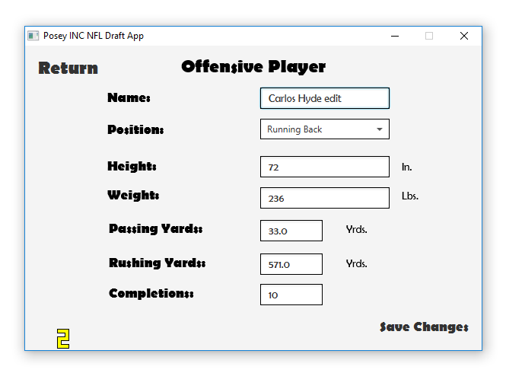
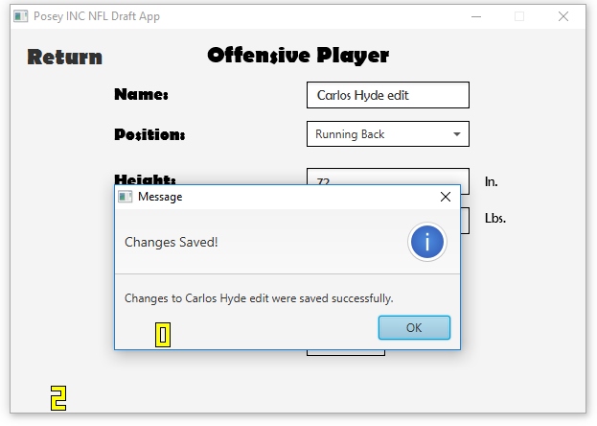
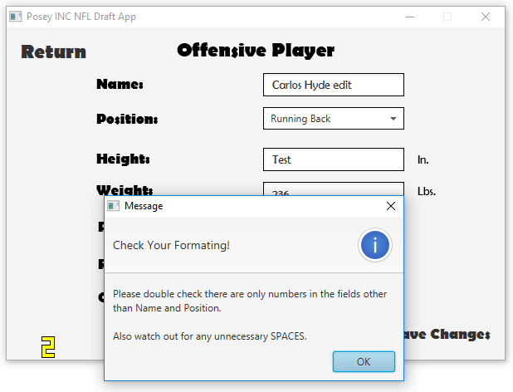

Slide 13
Stat Screen (If Offensive Player was selected)
Shows All of player’s stats
Name
Position
Height
Weight
Interceptions
Tackles
Fumbles
Every field is editable, and upon editing any value a save changes button appears
Return button takes you back to whatever previous screen was
Save Changes button updates the current player’s stats

Slide 14
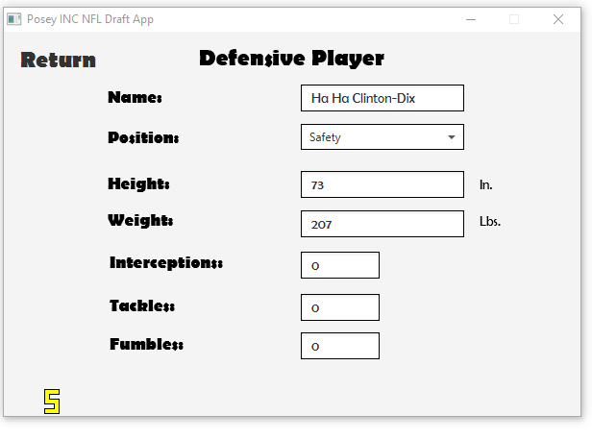
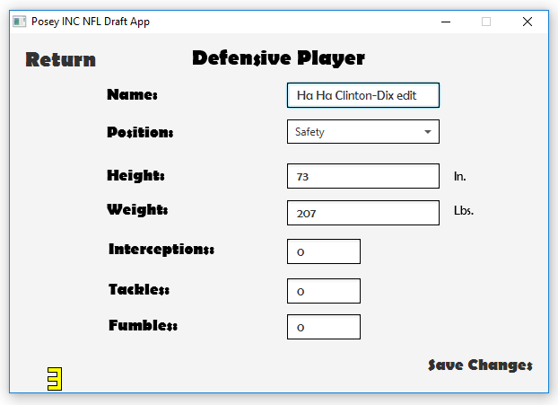
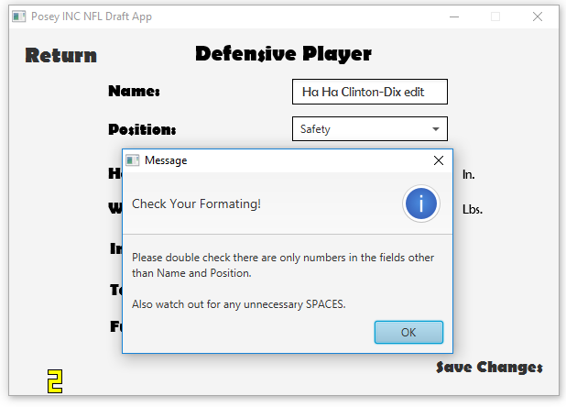
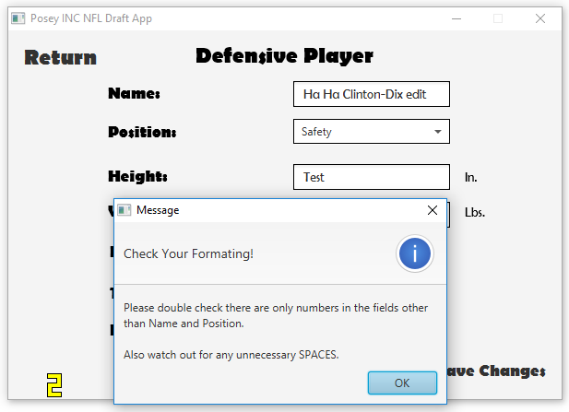

Slide 15
Stat Screen (If Create Player was selected)
Shows Four default fields as empty
Name
Position
Height
Weight
Every field is editable, and upon editing any value a save changes button appears
When a position is selected, the window changes depending on if the position was offensive or defensive
Return button takes you back to whatever previous screen was
Save Changes button saves the created player’s stats

Slide 16
